Slide 1
BANK LOAN CASE STUDY
Vivek Panchal

Slide 2
Description
This case study aims to give you an idea of applying EDA in a real business scenario. In this case study, apart from applying the techniques that you have learnt in the EDA module, you will also develop a basic understanding of risk analytics in banking and financial services and understand how data is used to minimize the risk of losing money while lending to customers.

Slide 3
Business Understanding
When the company receives a loan application, the company has to decide for loan approval based on the applicant’s profile. Two types of risks are associated with the bank’s decision:
If the applicant is likely to repay the loan, then not approving the loan results in a loss of business to the company.
If the applicant is not likely to repay the loan, i.e. he/she is likely to default, then approving the loan may lead to a financial loss for the company.

Slide 4
Approach
The data given below contains the information about the loan application at the time of applying for the loan. It contains two types of scenarios:
The client with payment difficulties: he/she had late payment more than X days on at least one of the first Y instalments of the loan in our sample
All other cases: All other cases when the payment is paid on time.
Steps in EDA:
Understanding data columns and data
Checking for missing data and outliers
Removing outliers
Univariate and Bivariate Analysis
Drawing Data Summary and Visulaization

Slide 5




Tech Stack Used:
As MS Excel can efficiently handle data upto 1M rows.
Python is being used throughout the project.
Language : Python
IDE : Jupyter Notebook

Slide 6
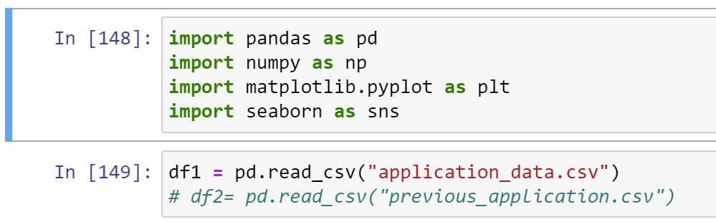
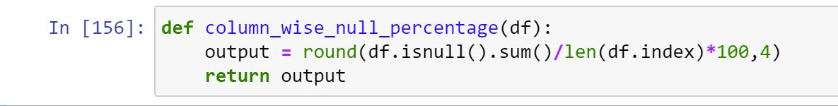
Insights and Results:
Indentify the missing data and use appropriate method to deal with it. (Remove columns/or replace it with an appropriate value)
Imported all needed libraries from python and read our csv file.
Finding how much data is missing in percentage.

Slide 7
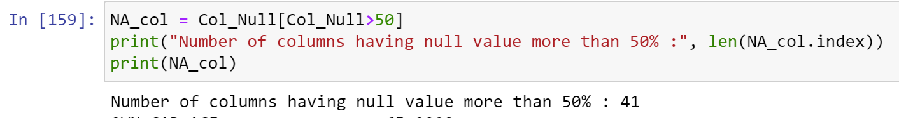
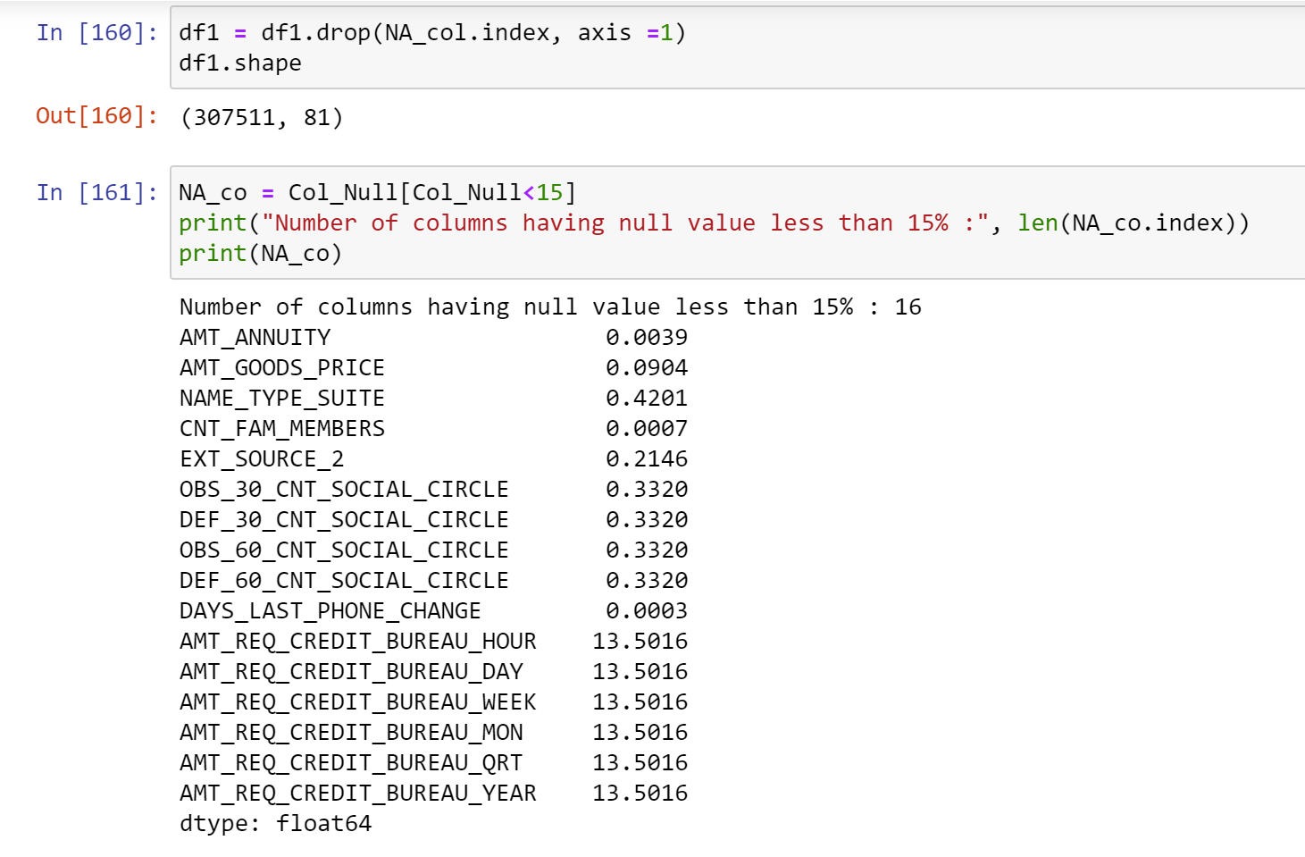
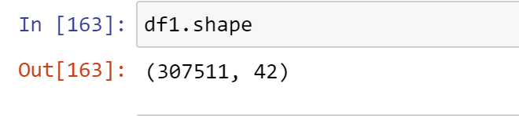
Handling missing data
Columns having missing data more than 50% is dropped.
Now our final data frame is of shape (307511, 42).

Slide 8
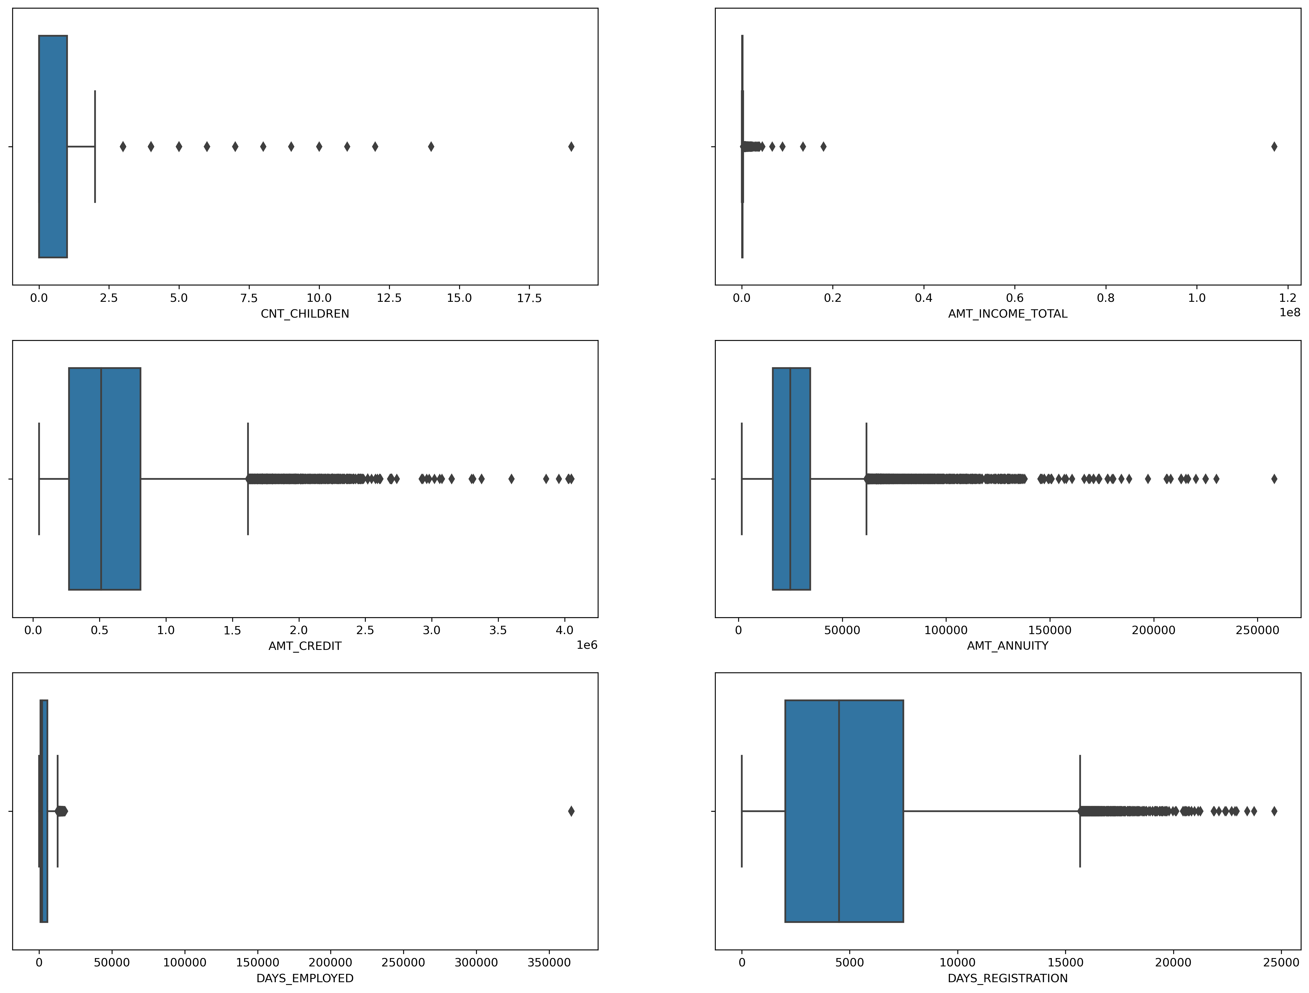
(2) Checking outliers for numerical variables
Box plot for different columns is used for outlier analysis.
AMT_CREDIT,AMT_ANNUITY, DAYS_EMPLOYED, DAYS_REGISTRATION data are skewed towards first quartile.
most of the data of CNT_CHILDREN are present in the first quartile.
single high value data point as outlier present in AMT_INCOME_TOTAL and Removal this point will drastically impact the box plot for further analysis.

Slide 9
(3) Explain the results of univariate, segmented univariate, bivariate analysis, etc. in business terms.
Dividing the dataset into two dataset of target=1(client with payment difficulties) and target=0(all other).
Count of target0_df: 282682
Count of target1_df: 24825
Percentage of people who paid their loan are: 91.93 % .
Percentage of people who did not paid their loan are: 8.07 %.
The Imbalance ratio is 11.48.

Slide 10
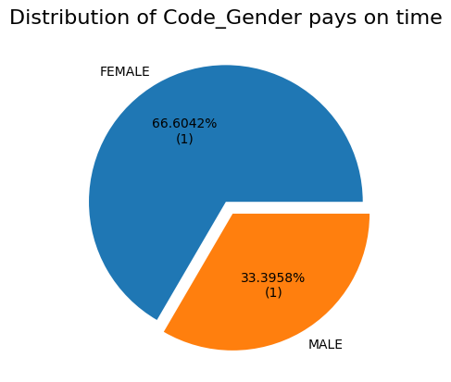
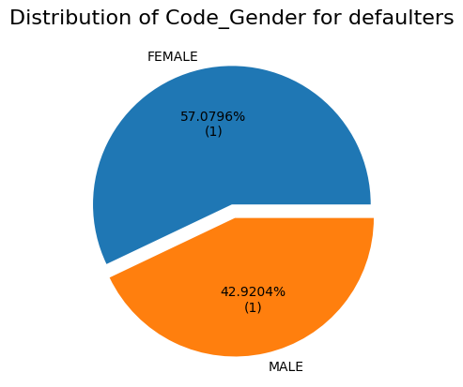

Slide 11
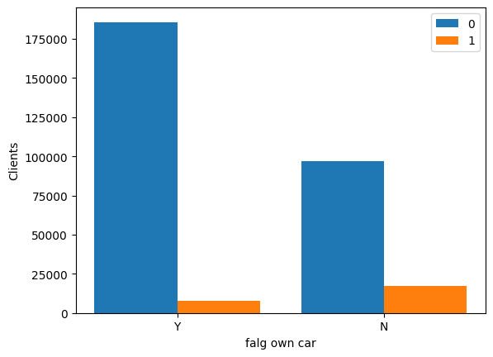
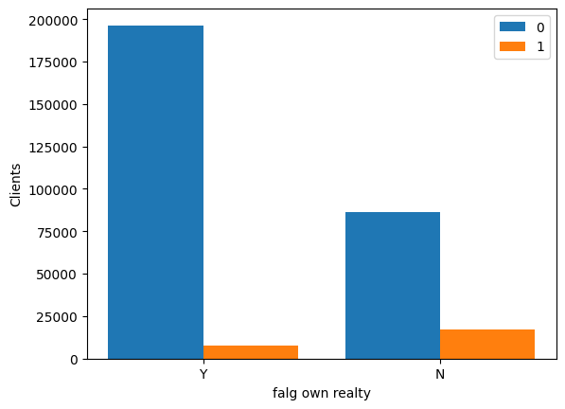
Own houses defaults similar to people without houses, but own car defaults less.

Slide 12
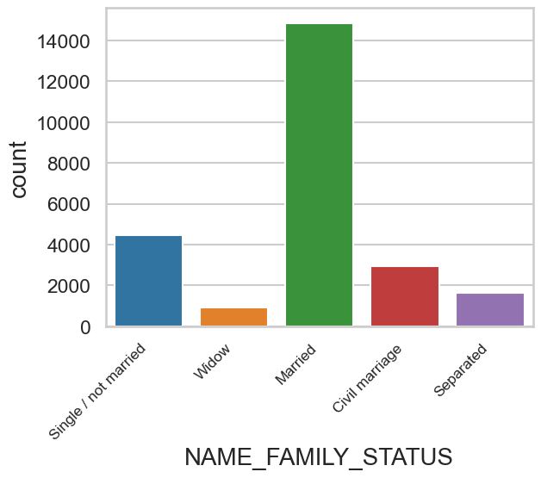
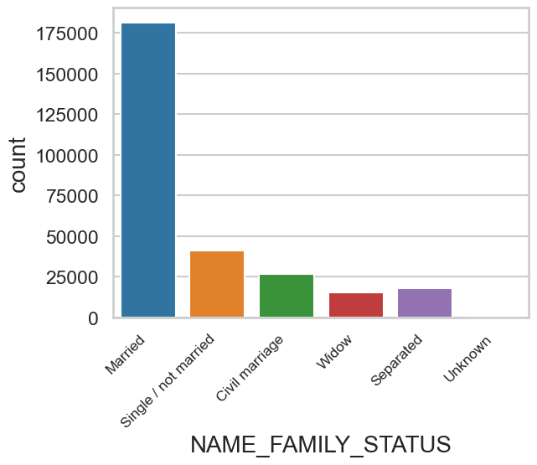
Married people defaults less.

Slide 13
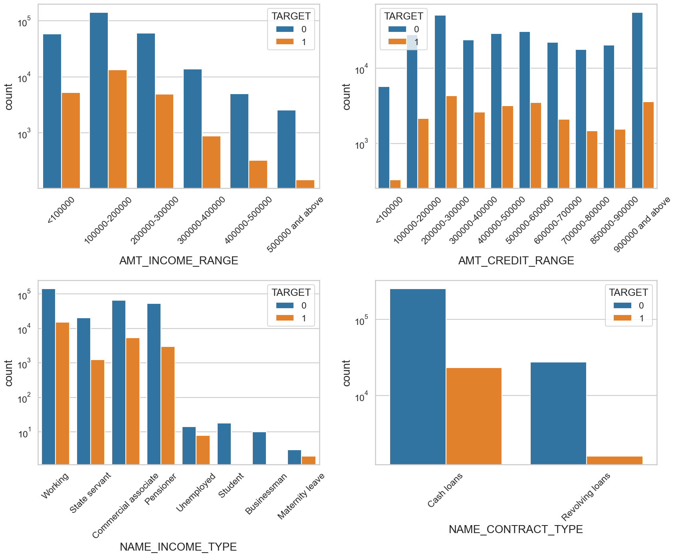
Univariate analysis Count Plot

Slide 14
AMT_INCOME_RANGE : * The people having 100000-200000 are havign higher number of loan and also having higher in defaulter * The income segment having >500000 are having less defaulter.
AMT_CREDIT_RANGE: * The people having <100000 loan are less defaulter. * income having more than >100000 are almost equal % of loan defaulter
NAME_INCOME_TYPE: * Student pensioner and business have higher percentage of loan repayment. * Working, State servant and Commercial associates have higher default percentage. * Maternity category is significantly higher problem in repayment.
NAME_CONTRACT_TYPE * For contract type ‘cash loans’ is having higher number of credits than ‘Revolving loans’ contract type. * From the above graphs we can see that the Revolving loans are small amount compared to Cash loans but the % of non payment for the revolving loans are comparatively high.

Slide 15
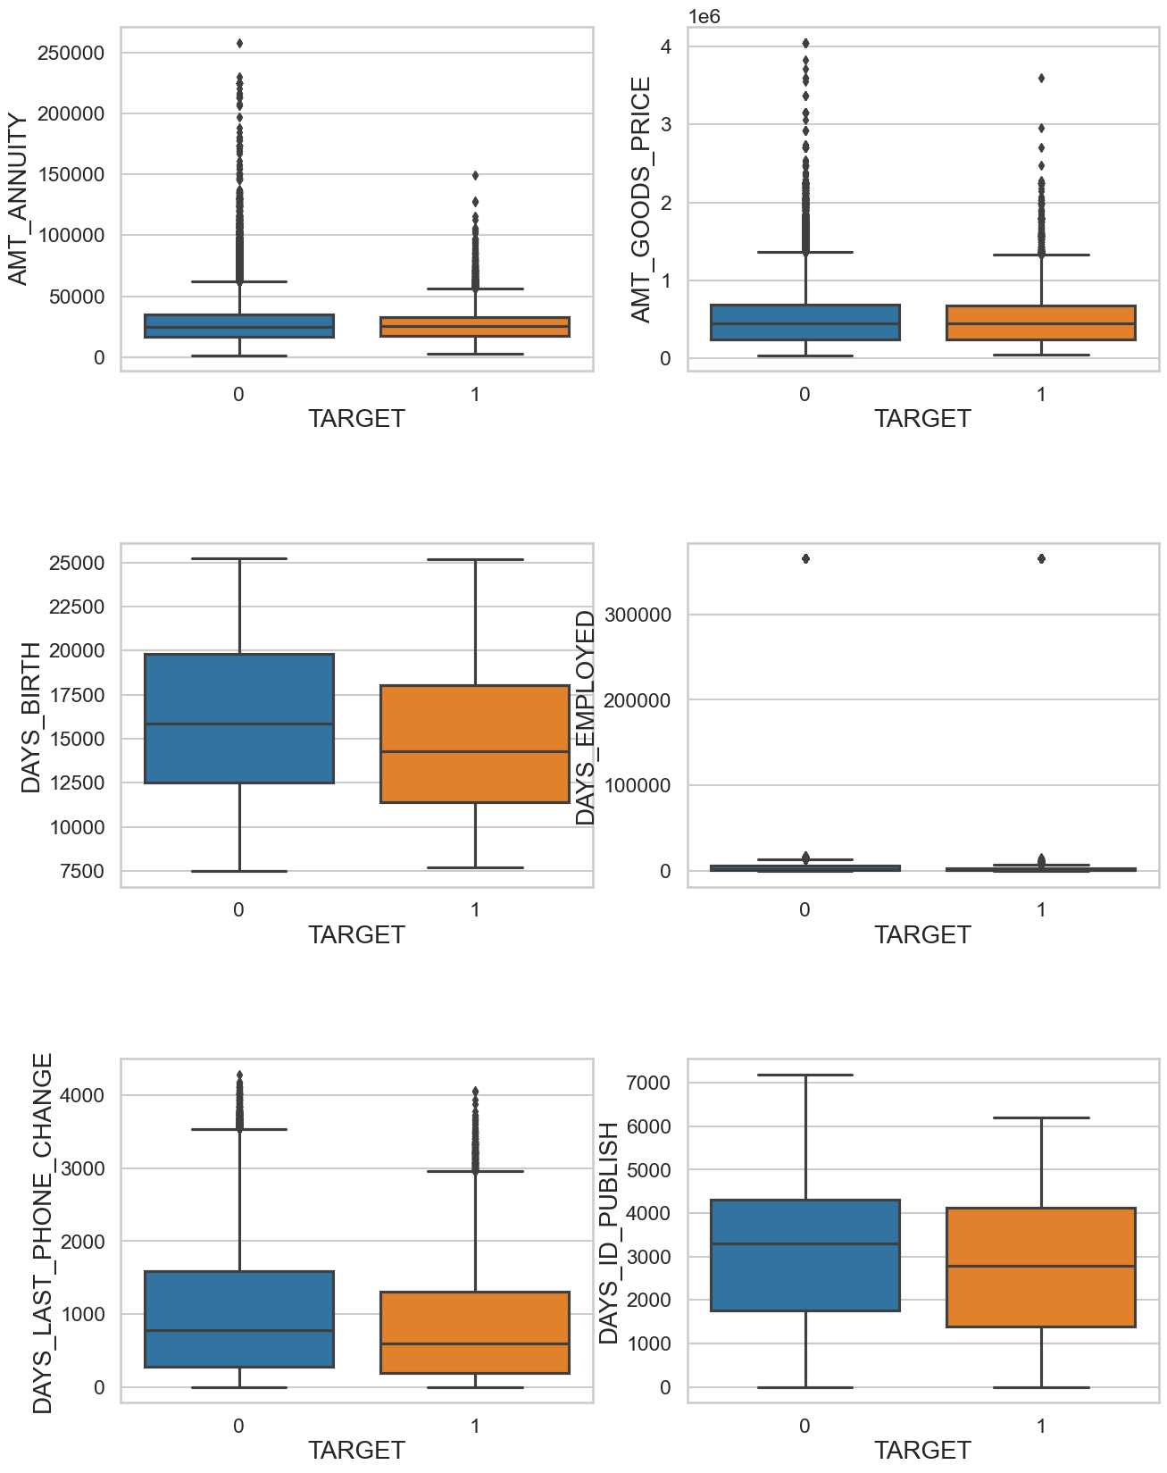
Univariate analysis of continuous variables
Day_Birth: The people having higher age are having higher probability of repayment.
Some outliers are observed in In 'AMT_ANNUITY','AMT_GOODS_PRICE','DAYS_EMPLOYED', DAYS_LAST_PHONE_CHANGE in the dataset.
Less outlier observed in Days_Birth and DAYS_ID_PUBLISH
1st quartile is smaller than third quartile in In 'AMT_ANNUITY','AMT_GOODS_PRICE', DAYS_LAST_PHONE_CHANGE.
In DAYS_ID_PUBLISH: people changing ID in recent days are relatively prone to be default.
There is single high value data point as outlier present in DAYS_EMPLOYED. Removal this point will drastically impact the box plot for further analysis.

Slide 16
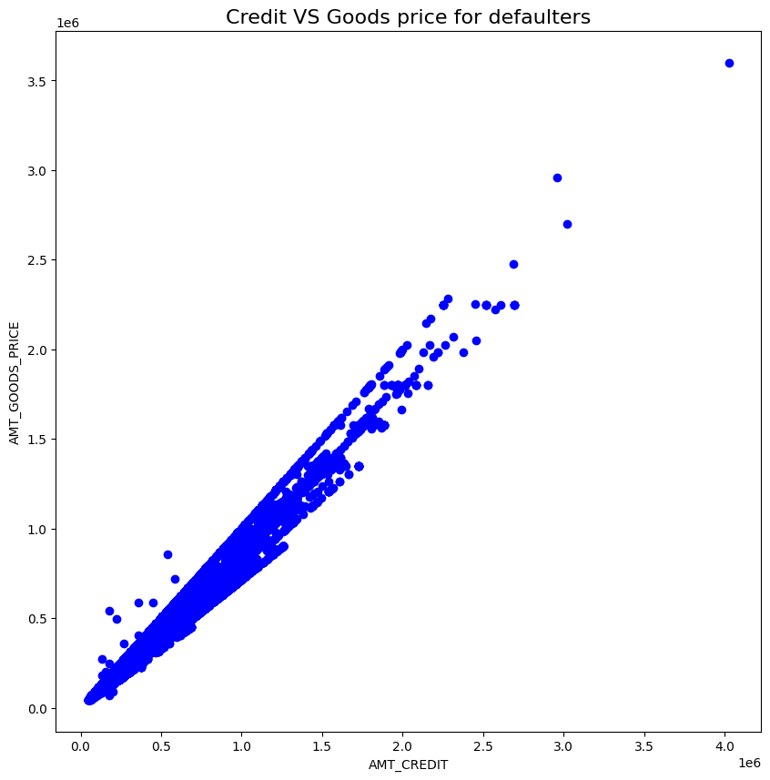
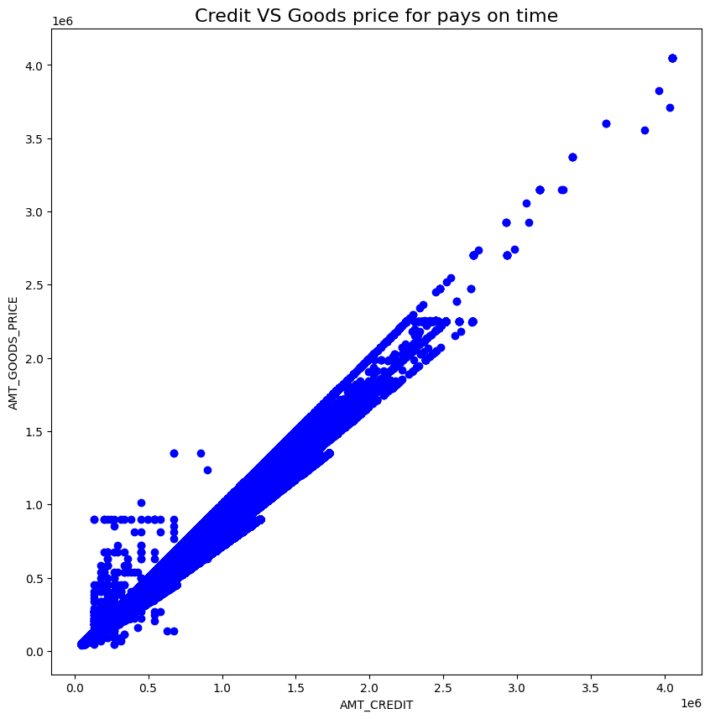
Strong correlation between AMT_CREDIT and AMT_GOODS_PRICE. Defaulters are less where amount is less than 150000.

Slide 17
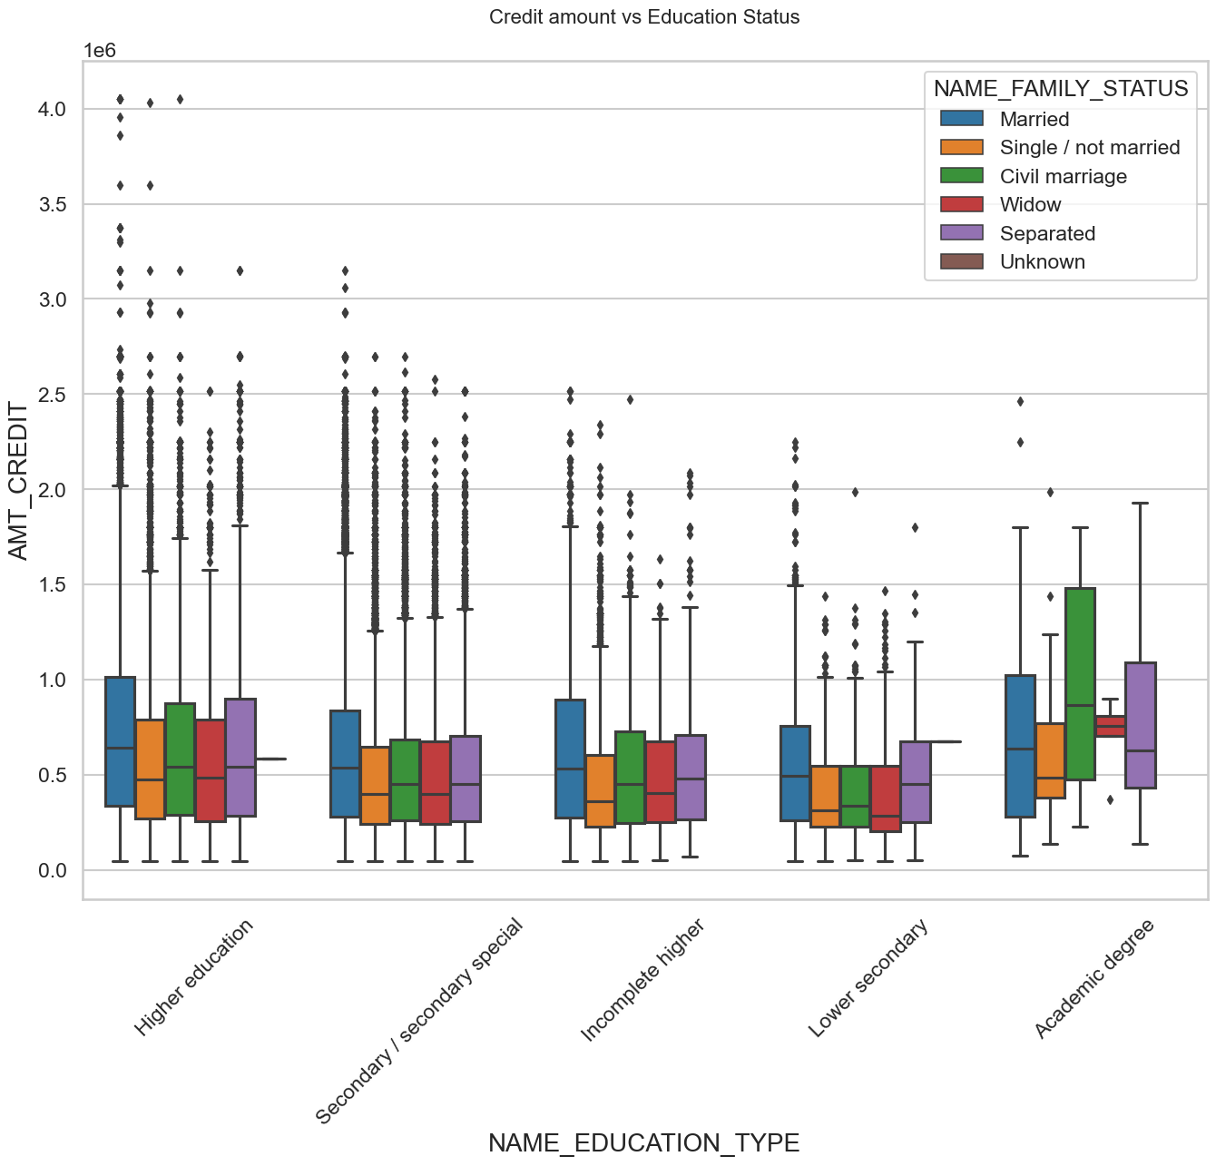
Bivariate analysis for numerical variables (0)
Family status of 'civil marriage', 'marriage' and 'separated' of Academic degree education are having higher number of credits than others.
Also, higher education of family status of 'marriage', 'single' and 'civil marriage' are having more outliers. Civil marriage for Academic degree is having most of the credits in the third quartile.

Slide 18
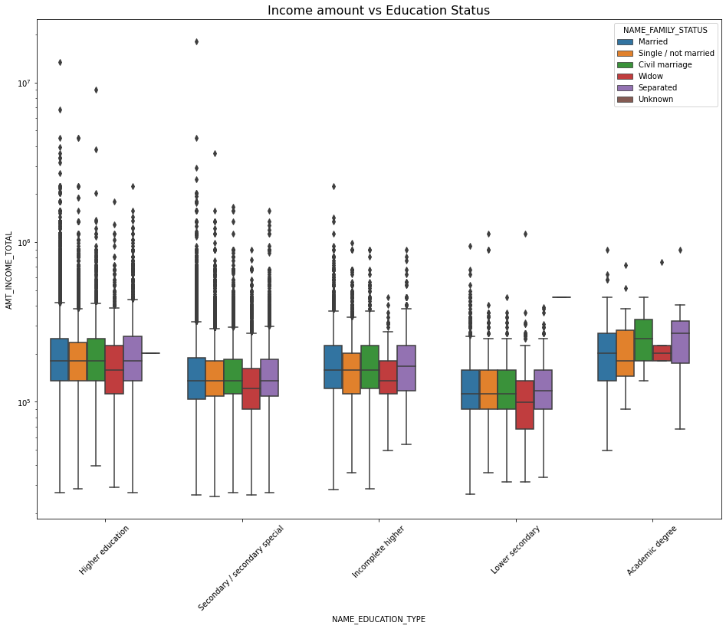
In Education type 'Higher education' the income amount is mostly equal with family status. It does contain many outliers.
Less outlier are having for Academic degree but there income amount is little higher that Higher education.
Lower secondary of civil marriage family status are have less income amount than others.

Slide 19
Bivariate analysis for numerical variables (1)
Observations are Quite similar with Target 0
Family status of 'civil marriage', 'marriage' and 'separated' of Academic degree education are having higher number of credits than others.
Most of the outliers are from Education type 'Higher education' and 'Secondary'.
Civil marriage for Academic degree is having most of the credits in the third quartile.

Slide 20
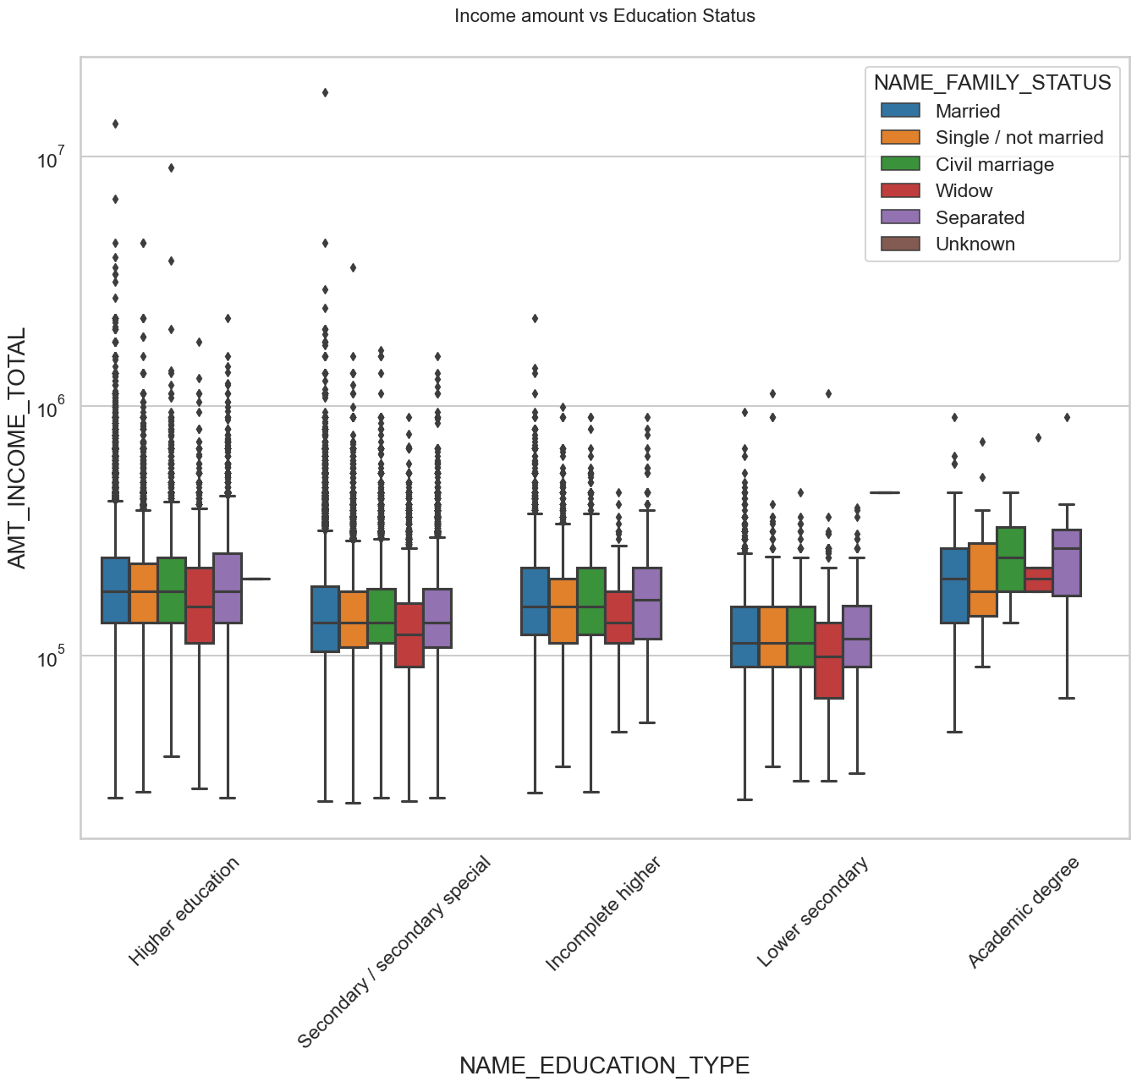
There is also have some similarity with Target0,
Education type 'Higher education' the income amount is mostly equal with family status.
Less outlier are having for Academic degree but there income amount is little higher that Higher education.
Lower secondary are have less income amount than others.

Slide 21
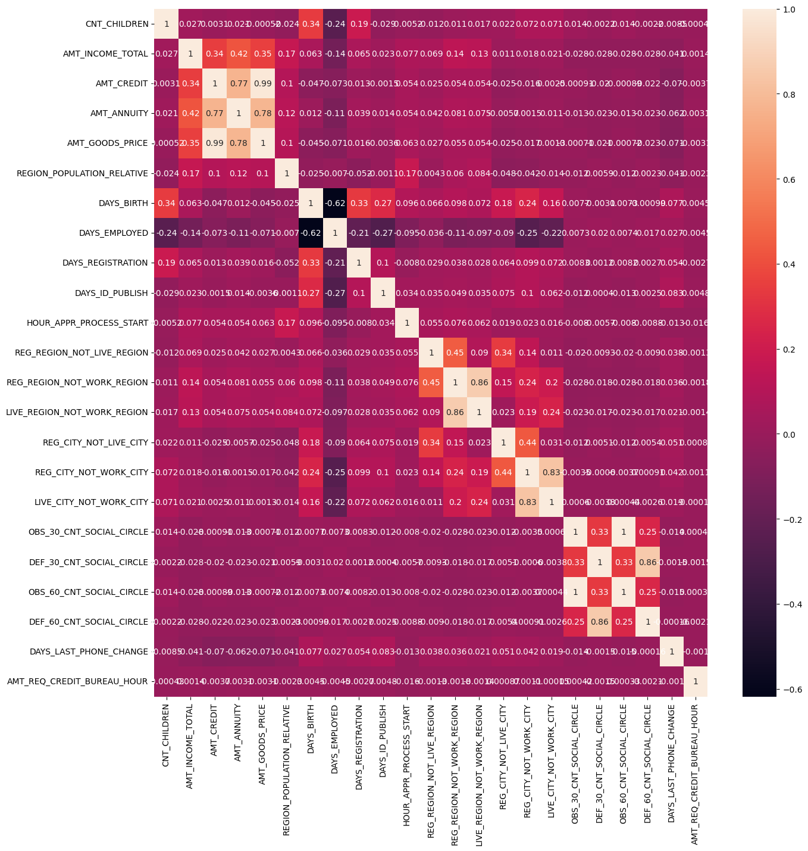

Slide 22
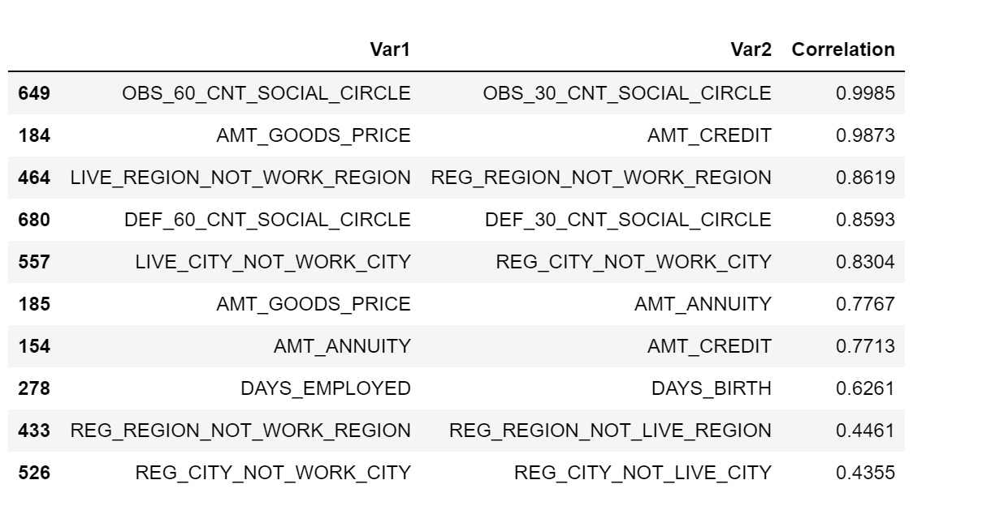
Top 10 correlated variables: target 0

Slide 23
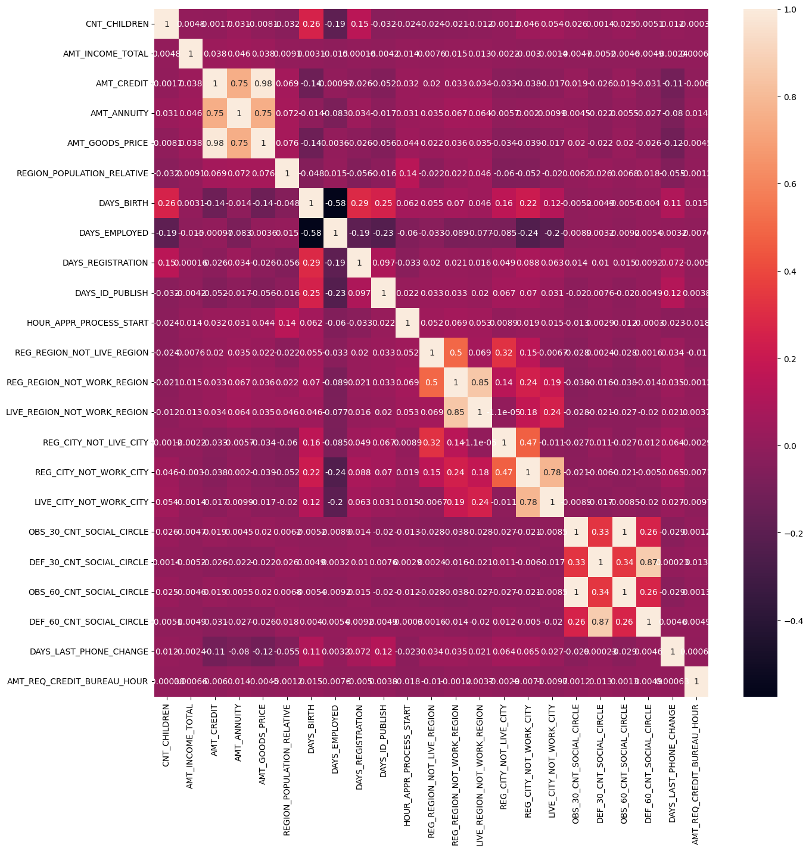

Slide 24
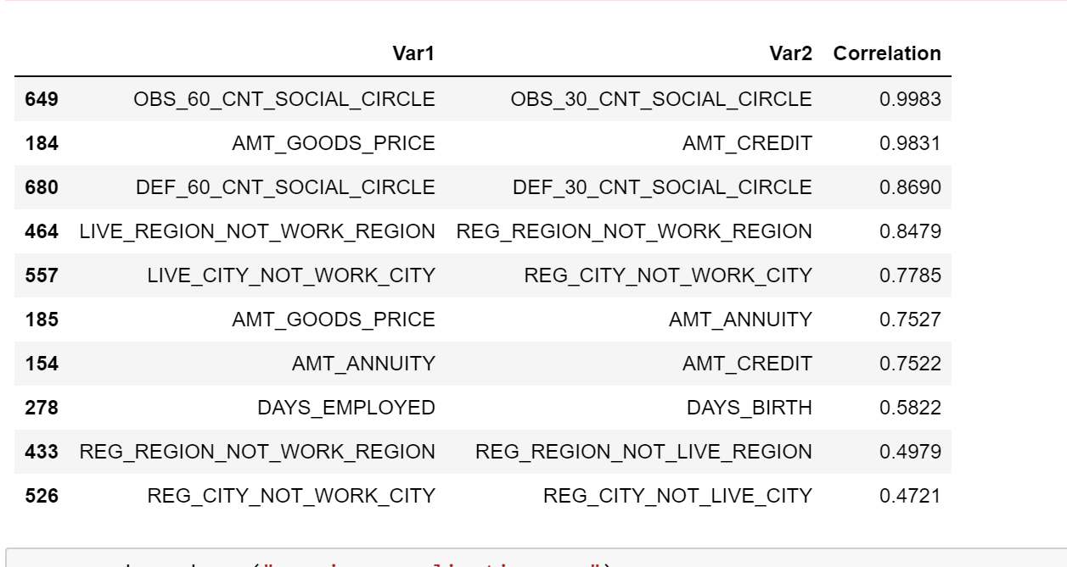
Top 10 correlated variables: target 1
From the above correlation analysis it is infered that the highest corelation (~0.989) is between (OBS_60_CNT_SOCIAL_CIRCLE with OBS_30_CNT_SOCIAL_CIRCLE) and (AMT_GOODS_PRICE with AMT_CREDIT) which is same for both the data set.

Slide 25
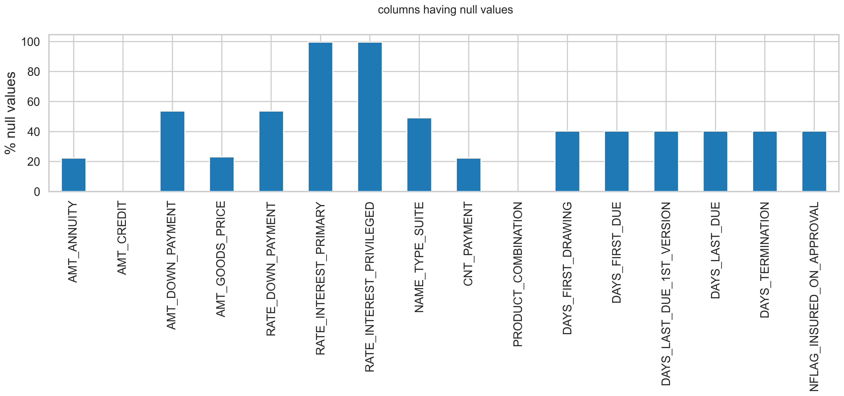
Analyzing Previous Application data with current data
Graphical representation of columns having % null values

Slide 26
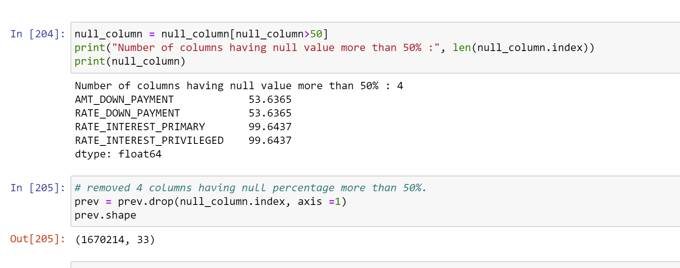
Dropping columns having 50% or more missing data.

Slide 27
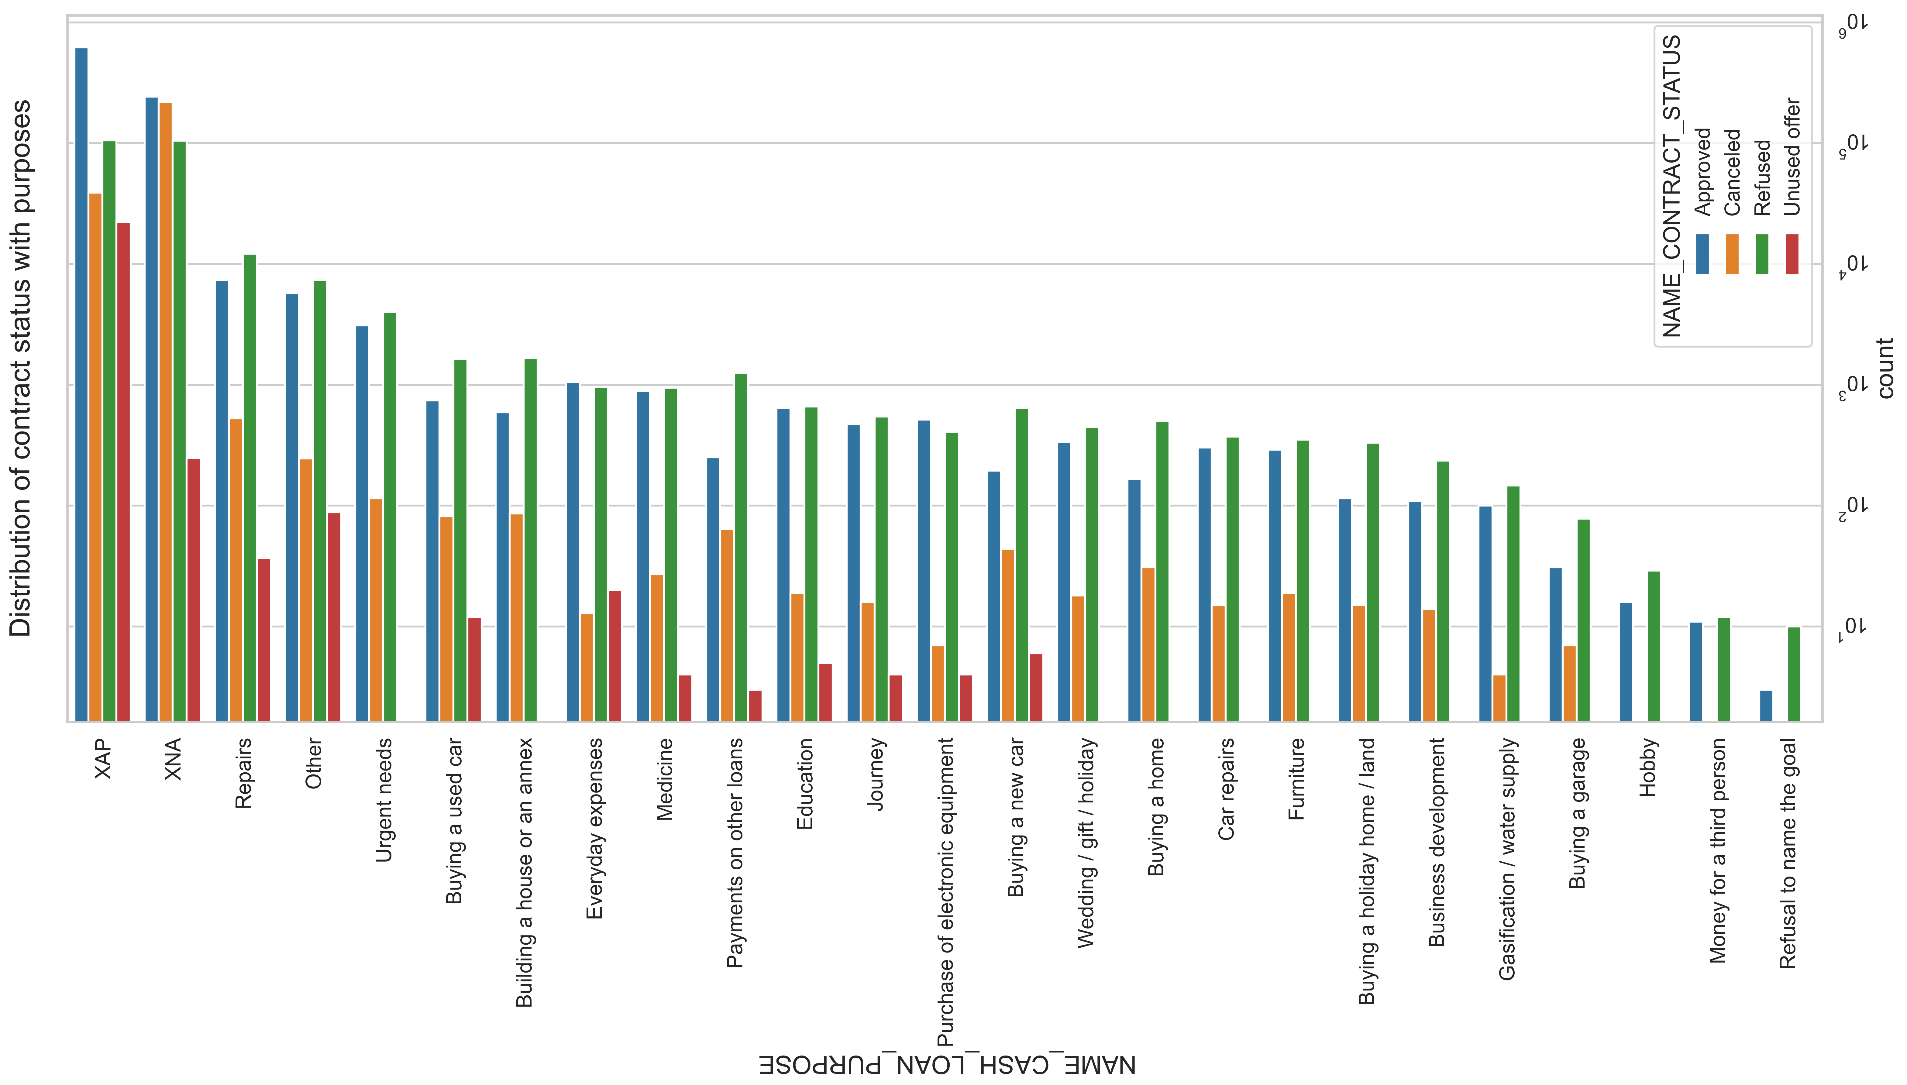
Most rejection of loans came from purpose 'repairs'. For education purposes we have equal number of approves and rejection Paying other loans and buying a new car is having significant higher rejection than approves.

Slide 28
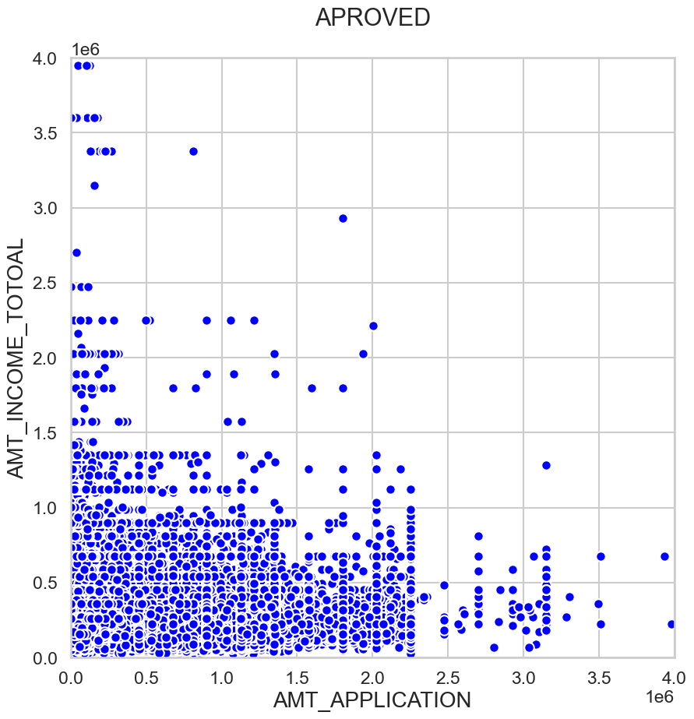
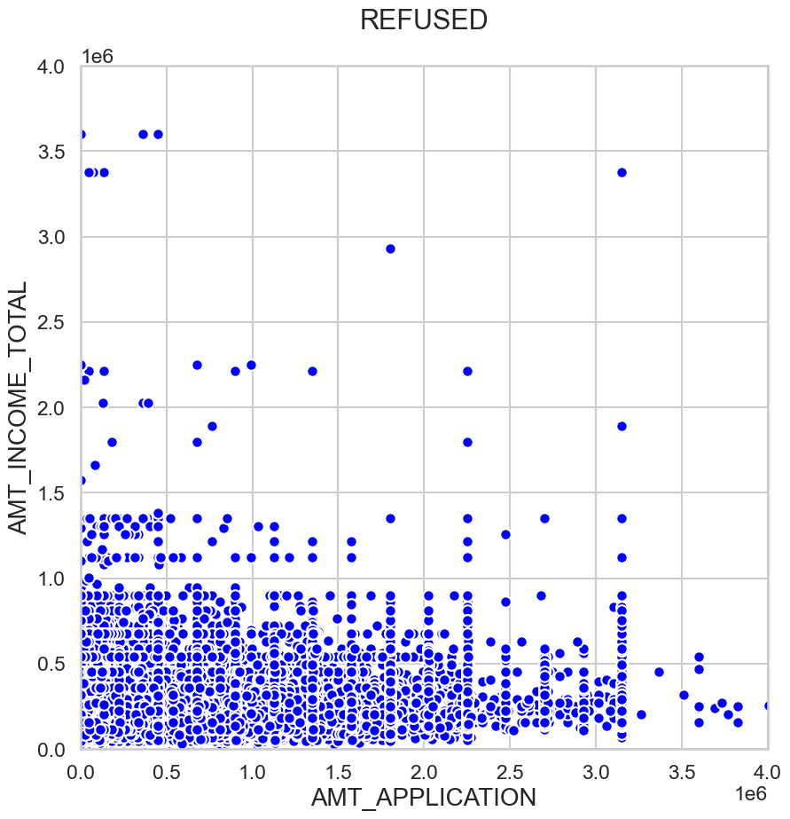
Loans higher than 2000000 have higher rejection rate.

Slide 29
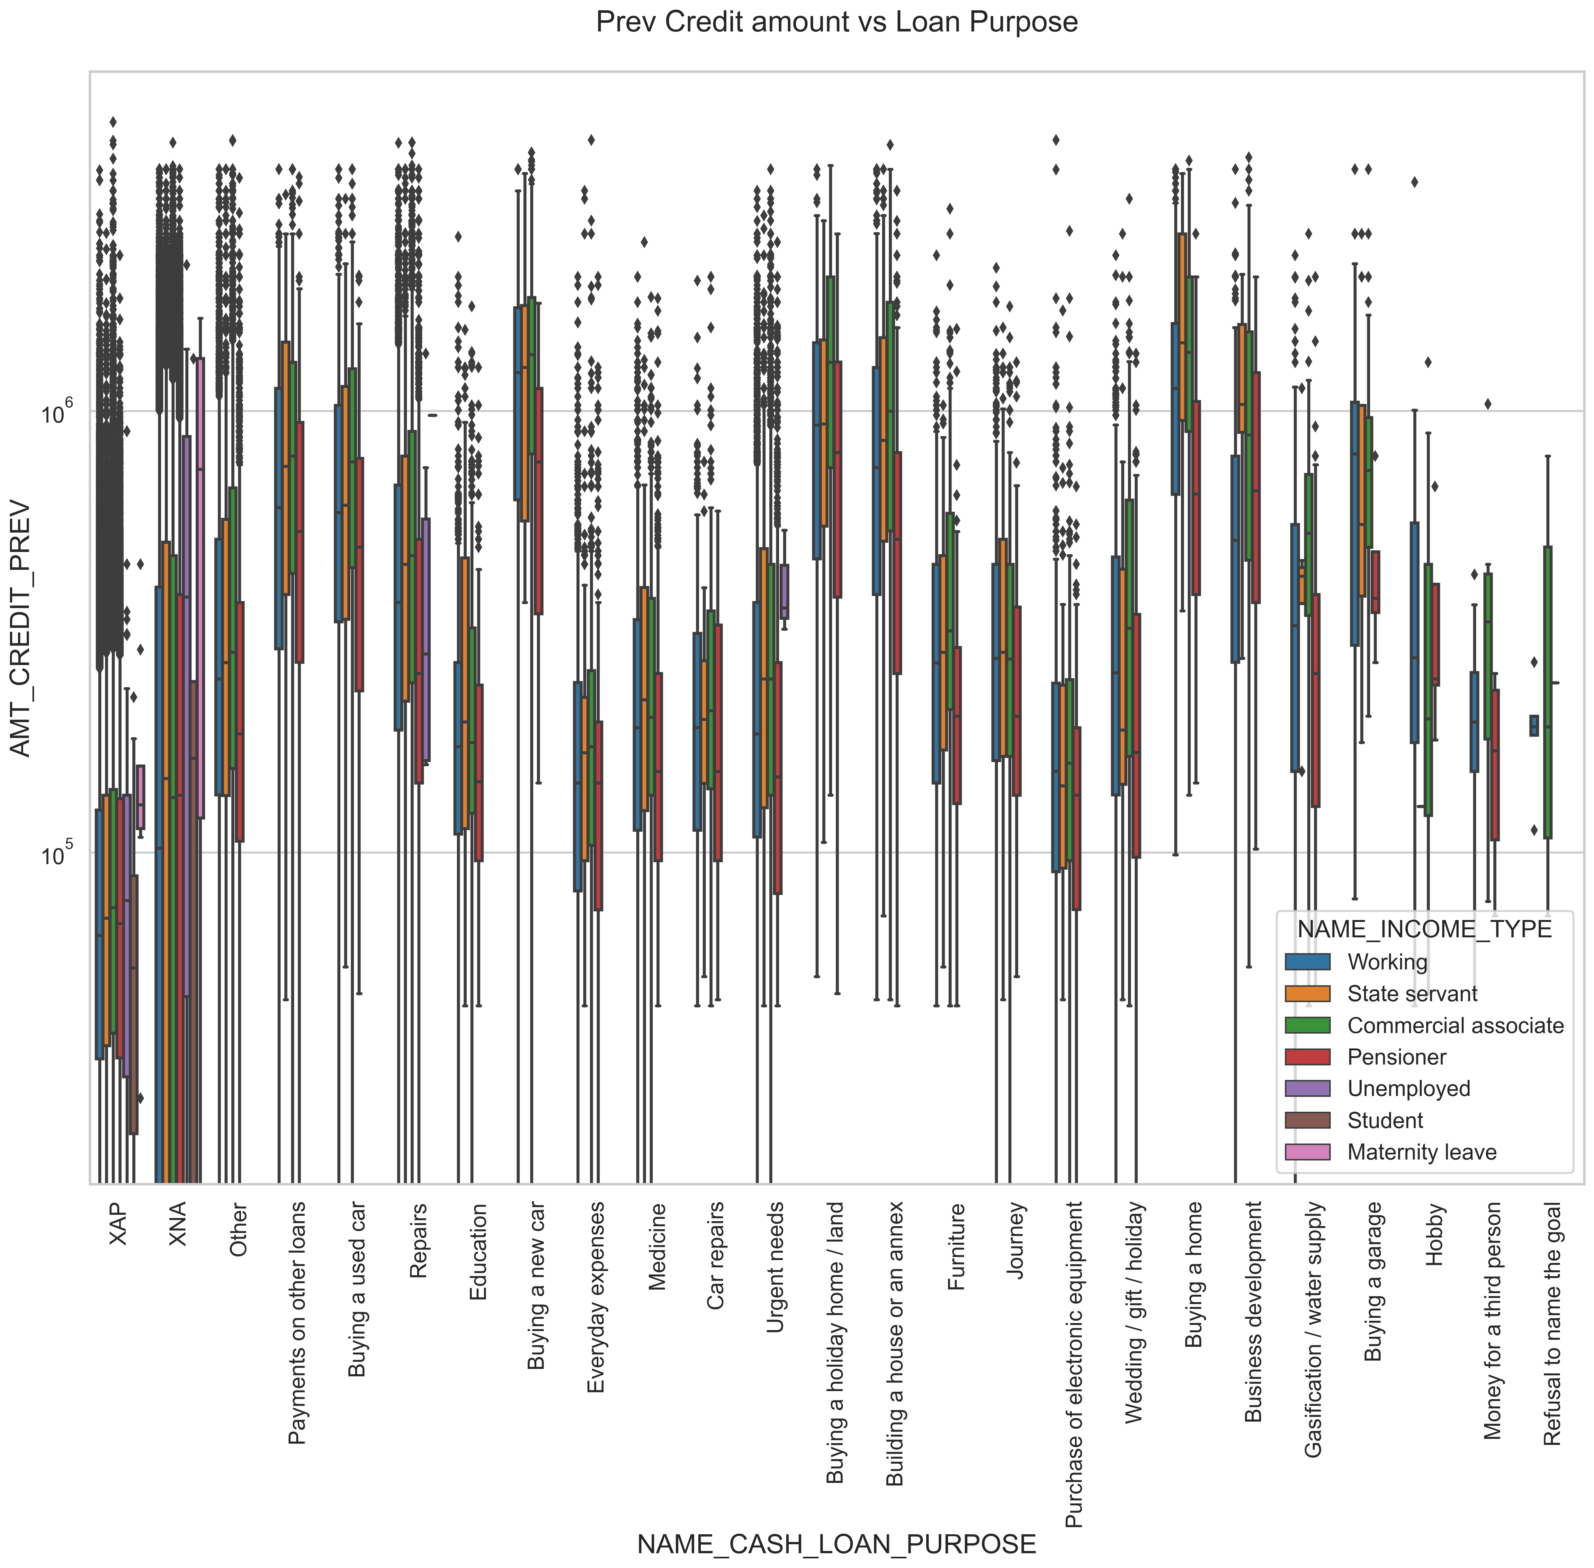
Biavariate analysis:
The credit amount of Loan purposes like 'Buying a home','Buying a land','Buying a new car' and'Building a house' is higher. Income type of state servants have a significant amount of credit applied Money for third person or a Hobby is having less credits applied for.

Slide 30
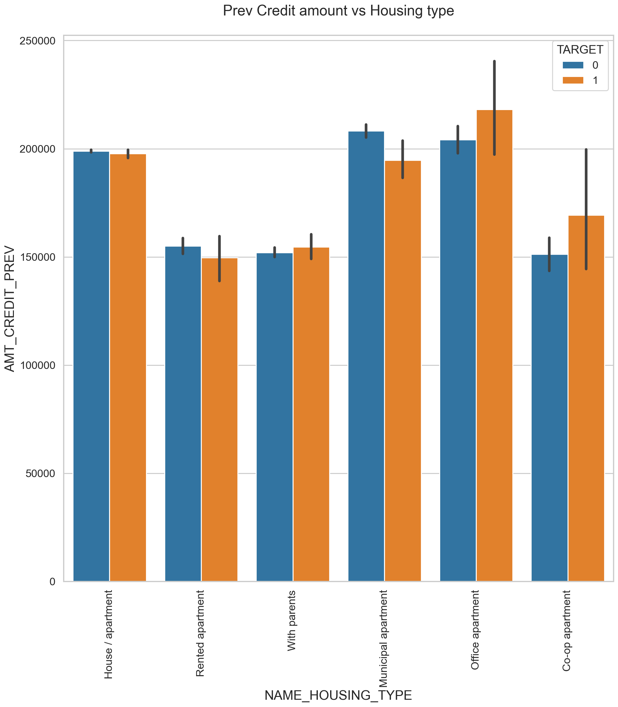
Box plotting for Credit amount prev vs Housing type
Here for Housing type, office apartment is having higher credit of target 0 and co-op apartment is having higher credit of target 1. So, we can conclude that bank should avoid giving loans to the housing type of co-op apartment as they are having difficulties in payment. Bank can focus mostly on housing type with parents or House\apartment or municipal apartment for successful payments.

Slide 31
Thank You….

Slide 32
Description: For you final project we are providing you with a dataset of a Customer Experience (CX) Inbound calling team for 23 days. Data includes Agent_Name, Agent_ID, Queue_Time [duration for which customer have to wait before they get connected to an agent], Time [time at which call was made by customer in a day], Time_Bucket [for easiness we have also provided you with the time bucket], Duration [duration for which a customer and executives are on call, Call_Seconds [for simplicity we have also converted those time into seconds], call status (Abandon, answered, transferred). A customer experience (CX) team consists of professionals who analyze customer feedback and data, and share insights with the rest of the organization. Typically, these teams fulfil various roles and responsibilities such as: Customer experience programs (CX programs), Digital customer experience, Design and processes, Internal communications, Voice of the customer (VoC), User experiences, Customer experience management, Journey mapping, Nurturing customer interactions, Customer success, Customer support, Handling customer data, Learning about the customer journey. Let’s look at some of the most impactful AI-empowered customer experience tools you can use today: Interactive Voice Response (IVR), Robotic Process Automation (RPA), Predictive Analytics, Intelligent Routing In a Customer Experience team there is a huge employment opportunities for Customer service representatives A.k.a. call centre agents, customer service agents. Some of the roles for them include: Email support, Inbound support, Outbound support, social media support. Inbound customer support is defined as the call centre which is responsible for handling inbound calls of customers. Inbound calls are the incoming voice calls of the existing customers or prospective customers for your business which are attended by customer care representatives. Inbound customer service is the methodology of attracting, engaging, and delighting your customers to turn them into your business' loyal advocates. By solving your customers' problems and helping them achieve success using your product or service, you can delight your customers and turn them into a growth engine for your business. Business Understanding: Advertising is a way of marketing your business in order to increase sales or make your audience aware of your products or services. Until a customer deals with you directly and actually buys your products or services, your advertising may help to form their first impressions of your business. Target audience for businesses could be local, regional, national or international or a mixture. So they use different ways for advertisement. Some of the types of advertisement are: Internet/online directories, Trade and technical press, Radio, Cinema, Outdoor advertising, National papers, magazines and TV. Advertising business is very competitive as a lot of players bid a lot of money in a single segment of business to target the same audience. Here comes the analytical skills of the company to target those audiences from those types of media platforms where they convert them to their customers at a low cost. Case Study Objectives: Attached is the dataset of Inbound calls of a ABC company from the insurance category. Use this data to answer the following: Calculate the average call time duration for all incoming calls received by agents (in each Time_Bucket). Show the total volume/ number of calls coming in via charts/ graphs [Number of calls v/s Time]. You can select time in a bucket form (i.e. 1-2, 2-3, …..) As you can see current abandon rate is approximately 30%. Propose a manpower plan required during each time bucket [between 9am to 9pm] to reduce the abandon rate to 10%. (i.e. You have to calculate minimum number of agents required in each time bucket so that at least 90 calls should be answered out of 100.) Let’s say customers also call this ABC insurance company in night but didn’t get answer as there are no agents to answer, this creates a bad customer experience for this Insurance company. Suppose every 100 calls that customer made during 9 Am to 9 Pm, customer also made 30 calls in night between interval [9 Pm to 9 Am] and distribution of those 30 calls are as follows: Now propose a manpower plan required during each time bucket in a day. Maximum Abandon rate assumption would be same 10%. Assumption: An agent work for 6 days a week; On an average total unplanned leaves per agent is 4 days a month; An agent total working hrs is 9 Hrs out of which 1.5 Hrs goes into lunch and snacks in the office. On average an agent occupied for 60% of his total actual working Hrs (i.e 60% of 7.5 Hrs) on call with customers/ users. Total days in a month is 30 days. How to do this Project?

